Slide 1
Health Care Bot Voice Assistant
PIP104 UNIVERSITY PROJECT-II
Review - 4
Batch Number: CST-19
Roll Number | Student Name
20201CST0166 | G.M.Sameer Khan
20201CST0108 | M.Naga Sudheer
20201CST0163 | SK.Haneef
Under the Supervision of,
Dr. S. Saravana Kumar
Assistant Professor – Selection Guide
School of Computer Science & Engineering
Presidency University

Slide 2
Introduction
In an era where technological advancements converge with healthcare, the development of intelligent systems stands as a beacon of innovation. This project introduces the "Healthcare Voice Assistance Bot," a sophisticated amalgamation of machine learning algorithms and voice-enabled technology designed to empower users in understanding and addressing potential health concerns. Harnessing the prowess of machine learning, this project intricately utilizes algorithms capable of analyzing symptoms such as fever, cough, difficulty in breathing, age, gender, cholesterol levels, and blood pressure. By inputting these vital health indicators, the system endeavors to predict diseases with precision and accuracy. The trained model, stored in a convenient pickle format, acts as the backbone, swiftly generating predictions based on the user-provided symptoms.

Slide 3
Literature Review
Author: John Smith
Date: 2020
Topic: "Applications of Machine Learning in Personalized Medicine"
Brief Summary: Explores the utilization of machine learning algorithms for tailoring medical treatments based on individual patient data, highlighting improved treatment outcomes.
Advantages: Personalized treatment plans, enhanced precision in diagnostics.
Disadvantages: Data privacy concerns, potential bias in algorithm outcomes.
Drawbacks: Limited availability of comprehensive patient data for accurate predictions.

Slide 4
Research Gaps Identified
Integration of in Remote Patient Monitoring: Rebecca White's work emphasizes the benefits of in remote patient monitoring. However, existing literature often focuses on the advantages without sufficiently addressing the challenges of integrating systems into diverse healthcare infrastructures, especially in resource-limited settings. Future research could explore strategies for seamless integration and address concerns related to connectivity, infrastructure, and scalability
Enhanced Personalization in Medicine: Authors such as Rachel Garcia emphasize the potential of -driven personalized medicine. Despite this, gaps remn in the literature concerning the integration of diverse data sources, including genetic, lifestyle, and environmental factors, into actionable treatment plans. Further research could focus on refining algorithms to handle complex data and develop robust models for personalized healthcare delivery.

Slide 5
Proposed Methodology
Speech Input: Voice to Text Conversion: Implement a speech recognition module (using libraries like PyAudio or Speech Recognition) to convert user input in the form of spoken language into text data.
. Text to Speech Conversion: Generate Speech Output: Convert the processed text output from the algorithms into spoken language using text to speech (TTS) technology. Libraries like pyttsx3 can be used to convert the text based responses into spoken language for the userText-to-Speech Conversion:
. Integration and User Interaction: Integration of Modules: Integrate the speech recognition, processing, and texttospeech conversion modules into a cohesive system, allowing seamless data flow and interaction.
Voice Synthesis: Ensure the synthesized voice output is clear, natural-sounding, and easily understandable for the user, maintaining a smooth conversational experience.

Slide 6
Objectives
1. Design and Implement Algorithms: Develop algorithms to analyze medical images, predict patient outcomes, or assist in treatment recommendations.
2. Integration of with Healthcare Systems: Integrate capabilities seamlessly into existing healthcare systems for real-time analysis and decision-making.
3. Validation and Testing: Conduct rigorous testing and validation of models to ensure accuracy, reliability, and safety in healthcare applications.
4. User-Friendly Interfaces: Create user interfaces that are intuitive, easy to use, and accessible for both healthcare professionals and patients.
5. Compliance and Ethics: Ensure compliance with healthcare regulations, data privacy laws, and ethical considerations in -driven healthcare solutions.

Slide 7
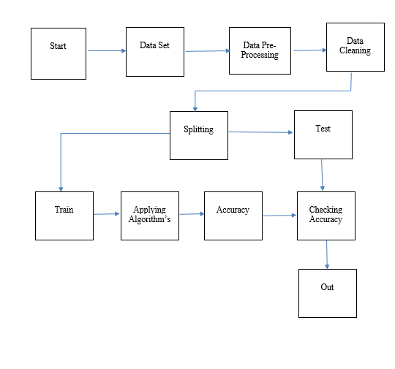
System Design & Implementation

Slide 8
System Design & Implementation
Planning and Requirements Gathering: Define clear project goals, scope, and functionalities based on user needs. Gather detled requirements and create a roadmap for the healthcare system.
Technology Selection: Choose appropriate technologies, frameworks, and tools for different components of the system, such as: Programming language (e.g., Python for models) Database management systems Web or mobile development frameworks /ML libraries or APIs (such as TensorFlow, PyTorch, scikitlearn for models) Speech recognition and synthesis tools Security and compliance tools for handling healthcare data.
System Architecture and Design: Design the overall system architecture, including: Backend infrastructure for data storage, processing, and model deployment Frontend interfaces for user interaction (web or mobile interfaces) model integration and data flow within the system
Development: Develop the system components according to the design: Create models for health monitoring, personalized insights, and chatbot functionalities using machine learning or deep learning techniques. Implement speech recognition for voice input and texttospeech for voice output. Develop the user interface, ensuring it is intuitive and userfriendly.

Slide 9
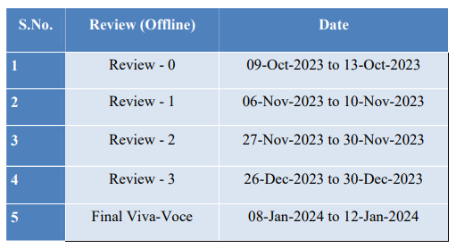
Timeline of Project

Slide 10
Outcomes / Results Obtained
1. Remote Patient Monitoring: Enables continuous health monitoring outside traditional healthcare settings, facilitating early detection of health issues and timely interventions.
2. 24/7 Healthcare Assistance: Provides immediate access to healthcare information and advice through driven chatbots or virtual assistants, improving healthcare accessibility.
3. Enhanced Diagnostics: driven diagnostic tools improve accuracy and efficiency in disease detection, leading to early diagnoses and timely treatments.

Slide 11
Conclusion
In conclusion, the development and implementation of the healthcare voice assistance bot represent a significant stride towards leveraging technology for proactive health management and disease prediction. The project successfully culminated in the creation of a sophisticated machine learning model capable of accurately predicting diseases based on input symptoms and user data. This achievement underscores the system's potential to serve as a valuable tool in guiding users towards better health outcomes by providing reliable predictions and personalized precautionary measures. The emphasis on an intuitive and efficient voice-based interaction system stands as a testament to the commitment to user accessibility and engagement. Enabling users to effortlessly communicate symptoms and receive accurate predictions and health guidance through spoken commands and responses has transformed the way individuals access healthcare information.

Slide 12
References
1]. Obermeyer, Z., Emanuel, E. J. (2016). Predicting the Future — Big Data, Machine Learning, and Clinical Medicine. The New England Journal of Medicine.
2]. Esteva, A. et al. (2017). Dermatologist-level classification of skin cancer with deep neural networks. Nature.
3]. Rajkomar, A. et al. (2018). Scalable and accurate deep learning with electronic health records. NPJ Digital Medicine.
4]. Choi, E. et al. (2016). Doctor : Predicting Clinical Events via Recurrent Neural Networks. Journal of Machine Learning Research.
5]. Goldhahn, J. et al. (2018). Sharing Clinical Data for Research Purposes: A Pilot With Hospital Patient Data. International Journal of Medical Informatics.

Slide 13
References
6]. Krittanawong, C. et al. (2020). Artificial Intelligence in Precision Cardiovascular Medicine. Journal of the American College of Cardiology.
7]. Char, D. S. et al. (2018). Artificial Intelligence in Interventional Radiology: A Literature Review. Seminars in Interventional Radiology. 8]. Wang, F. et al. (2018). A Survey of Deep Learning Techniques for Radiotherapy Dose Prediction. Medical Physics.
9]. Li, X. et al. (2019). Application of Artificial Intelligence in Medical Image Analysis. Chinese Medical Journal.
10]. De Fauw, J. et al. (2018). Clinically applicable deep learning for diagnosis and referral in retinal disease. Nature Medicine.

Slide 14

Thank You

